Slide 1


Funktionale Programmierung
Word Count
Olanrewaju Ajibua und Tom Mihnjak

Slide 2
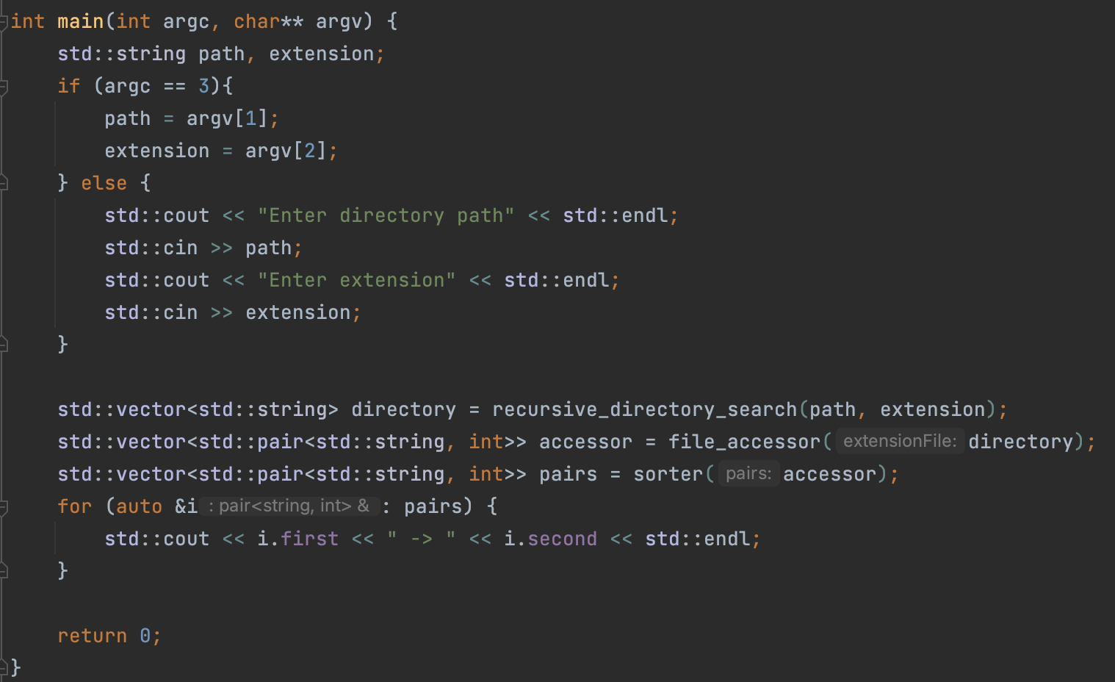
Main
FH TECHNIKUM WIEN
01

Slide 3
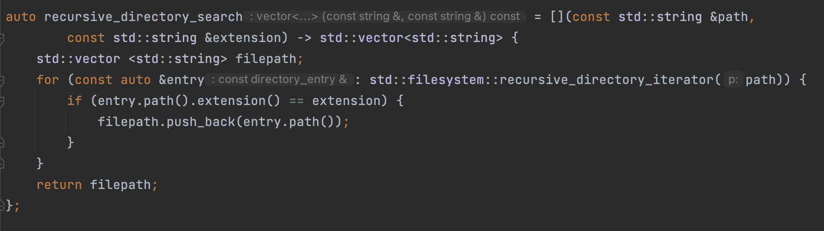
Recursive Directory Search
FH TECHNIKUM WIEN
02

Slide 4
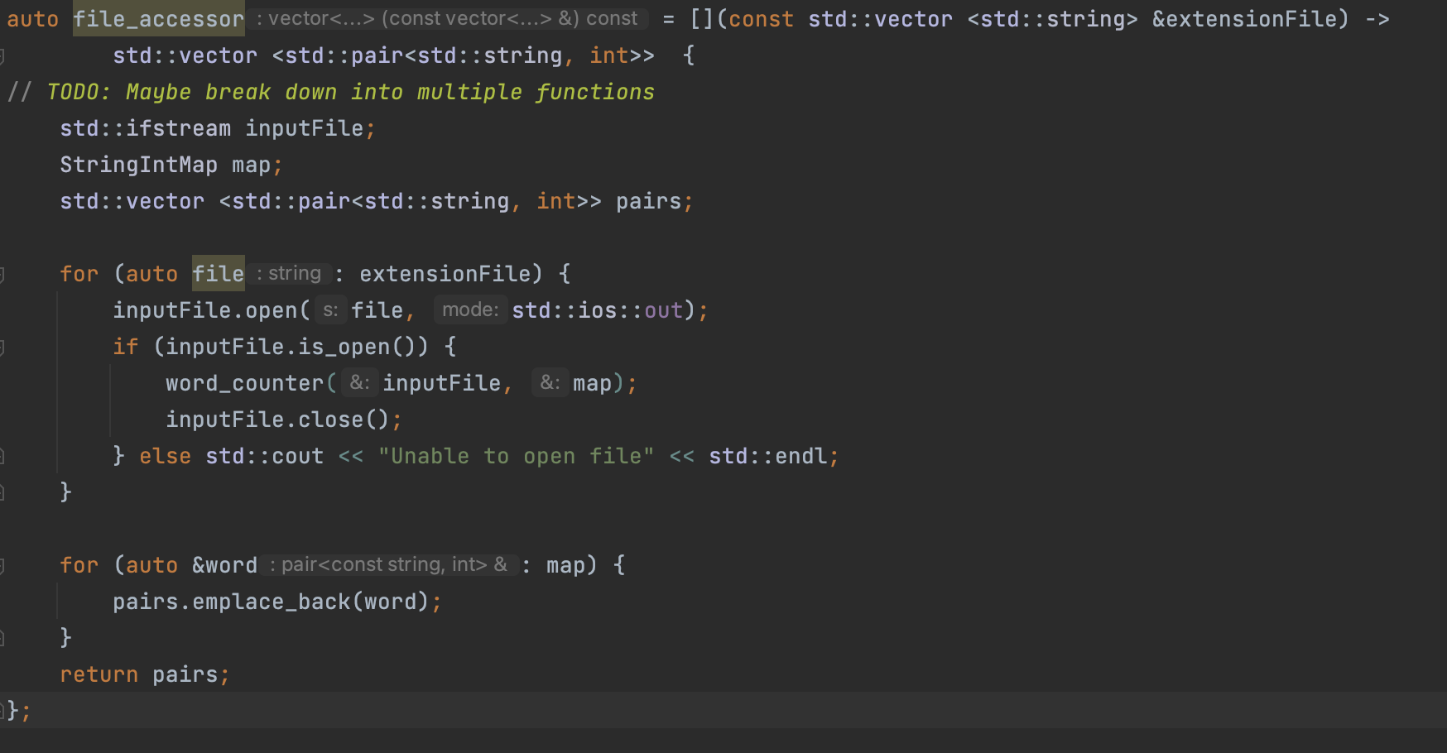
File Accessor
FH TECHNIKUM WIEN
03

Slide 5
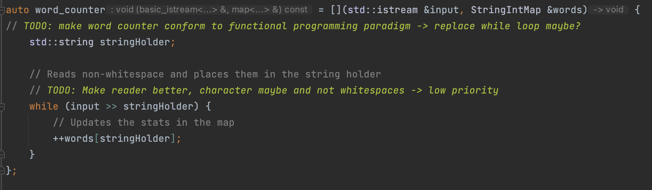
Word Counter
FH TECHNIKUM WIEN
04

Slide 6
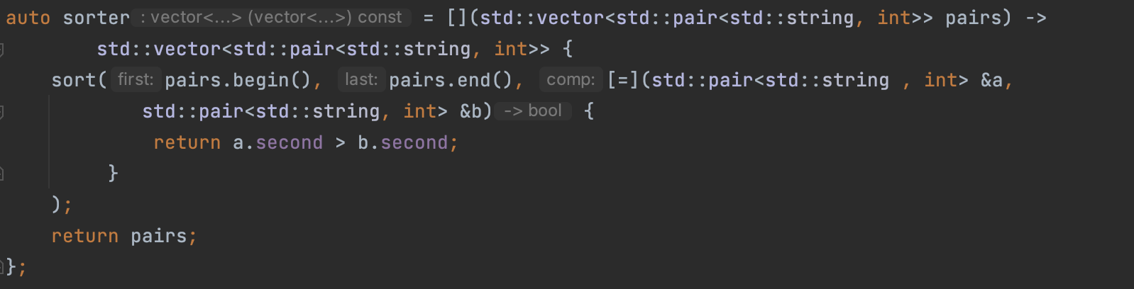
Sorter
FH TECHNIKUM WIEN
05

Slide 7
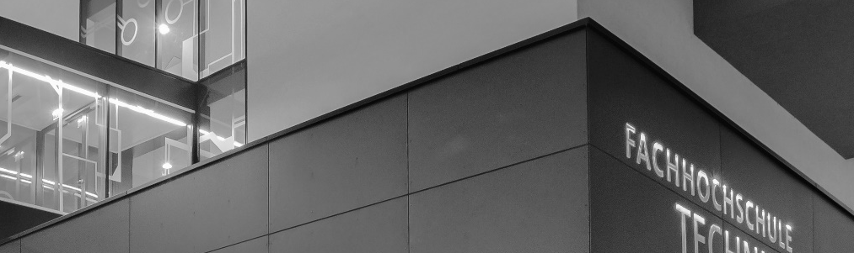
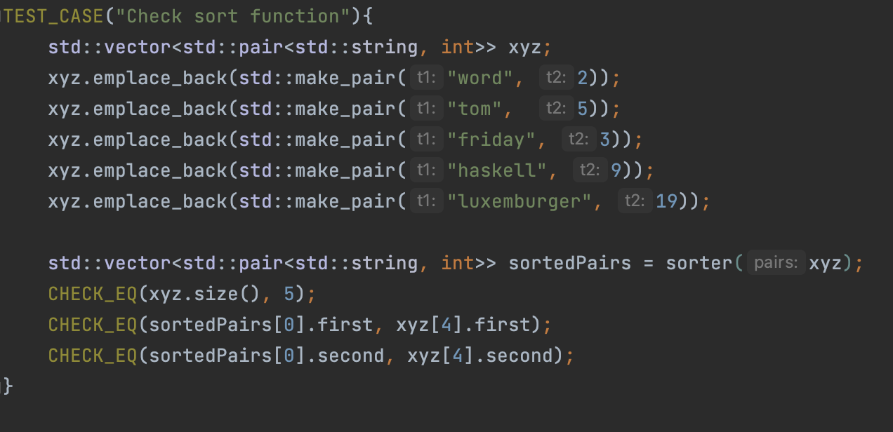
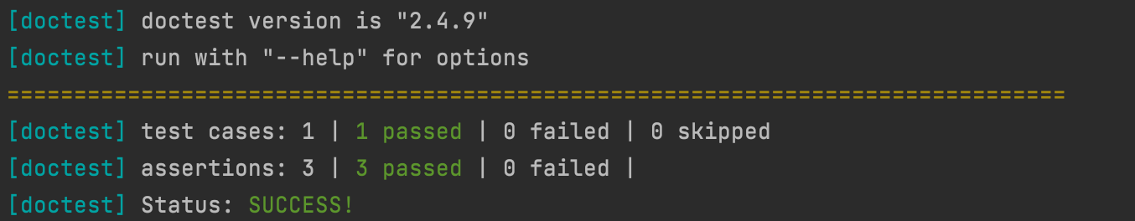
Test
FH TECHNIKUM WIEN
06

Slide 8
Lesson Learned / Failed Approaches
Writing & dealing with makefiles.
Lambdas.
Pure Functions
Implementing MapReduce.
Making word_count functional.
Tests.
FH TECHNIKUM WIEN
06

Slide 9
technikum-wien.at

